Slide 2
sample chapter warning
This is just sample chapter release from https://training.zdresearch.com . This sample moved out from our flash security module in advanced web application hacking training course.

Slide 3
Manual Review
Now as you learnt about flash security and how action script code works lets start on manual review of SWF files for XSS vulnerabilities.

Slide 4
Flash based XSS
In previous sections we already talked about flash security policy , sandbox model and also how action script works so in this section we want to talk about flash based XSS . Like other vulnerability type and like other start looking for vulnerabilities we need to understand where we can find user inputs but this time the process is a bit different. way ? Because as you know we are mostly dealing with compiled SWF files not action script source so what we should do now ? Well this stage is not that hard to pass we just need first to decompile the SWF and then start looking for vulnerabilities so lets go for a step by step example.

Slide 5
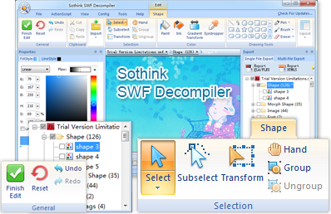
Flash based XSS
There are many different ways to decompile SWF files but as an offline decompile tool I prefer sothink swf decompiler from www.sothink.com but this tool is not free and will cost you 80$ .

Slide 6
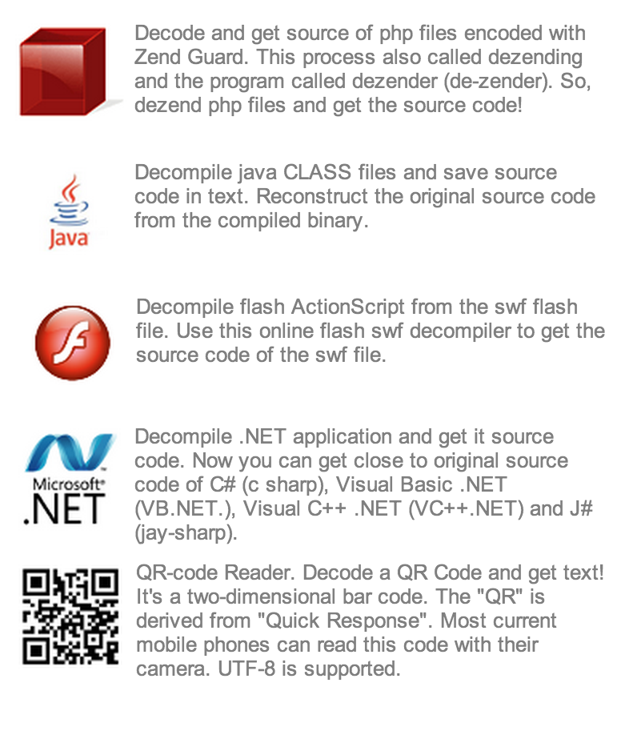
Flash based XSS
for free alternative and even better quality free alternative I’ll go for www.showmycode.com this is free and great because also offer Zend Guard, java class and .NET decompile .

Slide 7
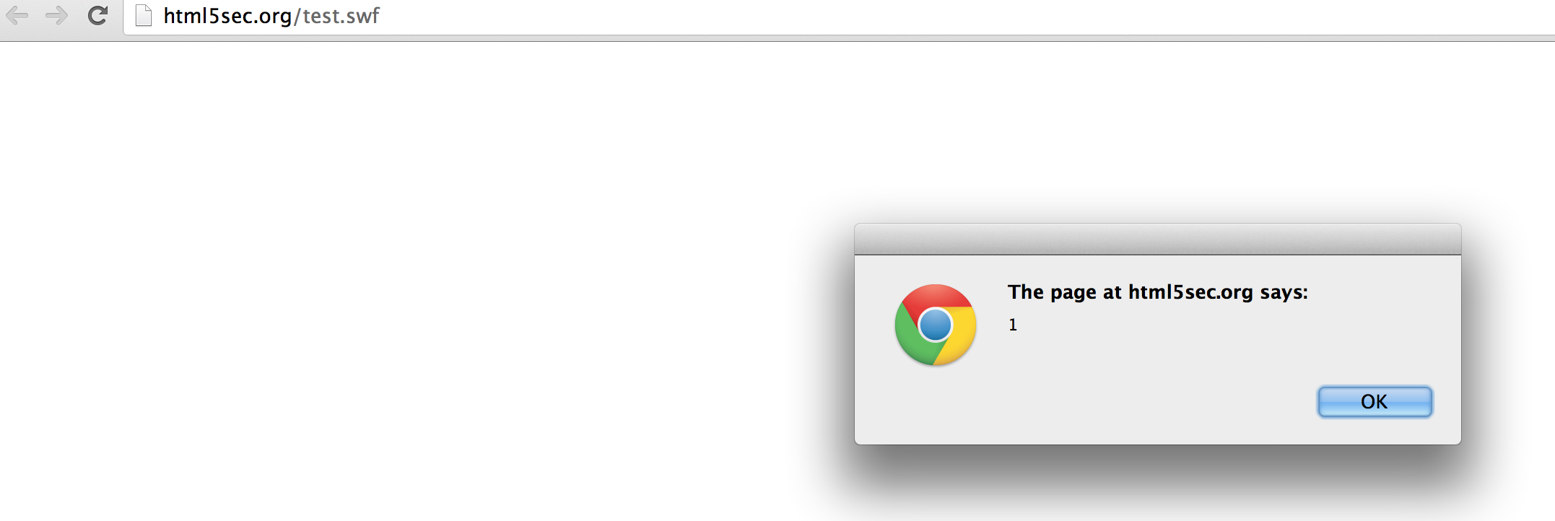
Flash based XSS
Now lets start by very very simple SWF file and then we will end with real world vulnerabilities like other sections. Just open your favorite browser and head on to http://html5sec.org/test.swf you will warm alert welcome.

Slide 8
Flash based XSS
So we want understand action scrip code behind this SWF so we will go to www.showmycode.com and use this URL http://html5sec.org/test.swf for start decompile process. The cool note about this site is it will support for both URL and files .
So we will just fill the single char captcha and click on Show My Code!

Slide 9
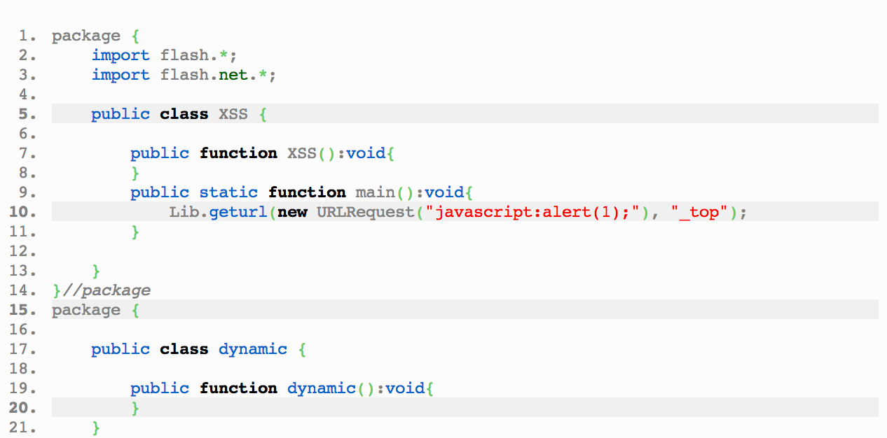
Flash based XSS
We will get ~500 line of action script as result but this is true and all these codes are for just alert message ? For sure not , most of these codes are just compiler generated code and we don’t have to deal with them we just need understand XSS class section.

Slide 10
Flash based XSS
As you can see there is simple class called XSS and this class contain simple XSS and static main methods and you should know why this code is like this as we already talked about writing basic action scrip codes. and in this case getURL is responsible for running JavaScript code. Here is getURL protoype.
So It load document from URL and will parse it . So if we pass javascript:alert(0) result is clear !
now please read adobe security note on it.
getURL(url:String, [window:String, [method:String]]) : Void
Security note: For Flash Player 8 and later, for local content running in a browser, calls to the getURL() function that specify the "javascript:" pseudo-protocol (for example, getURL("javascript:someFunction()")) are only permitted if the SWF file and the containing web page (if there is one) are in the local-trusted security sandbox.

Slide 11
Flash based XSS
So what about URLRequest we saw in code ? Simple it’s about action script 3 way to do it the prototype and info on previous slide was old action script 2 way to doing it and in our decompiled sample we are dealing with action script 3 so this is good to keep in mind how it possible to do XSS on getURL and action script 3. lets look at complete code.
So from flash lib example first called getURL and then from net it called URLRequest and passed javascirpt:alert to it .
class XSS {public static function main() { flash.Lib.getURL(new flash.net.URLRequest("javascript:alert(1);"),"_top"); }}

Slide 12
Flash based XSS
Now lets look at more cool sample head on to http://demo.testfire.net/vulnerable.swf

Slide 13
Flash based XSS
This example is really more cool and contains a lot of flash based XSS attacks. before start attacks we need to decompile it using show my code after decompile you can see the code is clear . So now will go for some of examples and do attack and explain code for you and will let you do others by your self as exercise . I like number 10 because it’s universal and almost work on every single browser. here is the code for this one.
So if the variable externalinterfaceVar is not undefinded it will call it from _root. (our input as know from previous section about it)
on (release) { if (externalInterfaceVar != undefined) { flash.external.ExternalInterface.call(_root.externalInterfaceVar); }}

Slide 14
Flash based XSS
So ExternalInterface is easy way to communicate between JS/HTML and ActionScript you can read more about it in adobe website.
http://help.adobe.com/en_US/FlashPlatform/reference/actionscript/3/flash/external/ExternalInterface.html
So if will run every JavaScript code and the variable is our example is externalinterfaceVar all we have to do is pass javascript code to in right? Lets try following URL in your browser .
Now click on 10 ExternalInterface
http://demo.testfire.net/vulnerable.swf?externalInterfaceVar=eval(eval(alert(/ZDResearch/)))

Slide 15
Flash based XSS
And here is result .

Slide 16
Flash based XSS
Very well so you can find this kind of XSS in a a lot of SWF files around the world now let me go on number 4 . Parameter in getURL javascript call. So here is the code .
Ok so here we are inside of eval actually we are at javascript:eval(‘escape(our code here)) ; so the easiest way to attack this code is using classic JS injection method it means we close quote and parenthesis and we will comment out the rest .
on (release) { geturl (("javascript:eval('" + escape(_root.getUrlJSParam)) + "')"); }

Slide 17
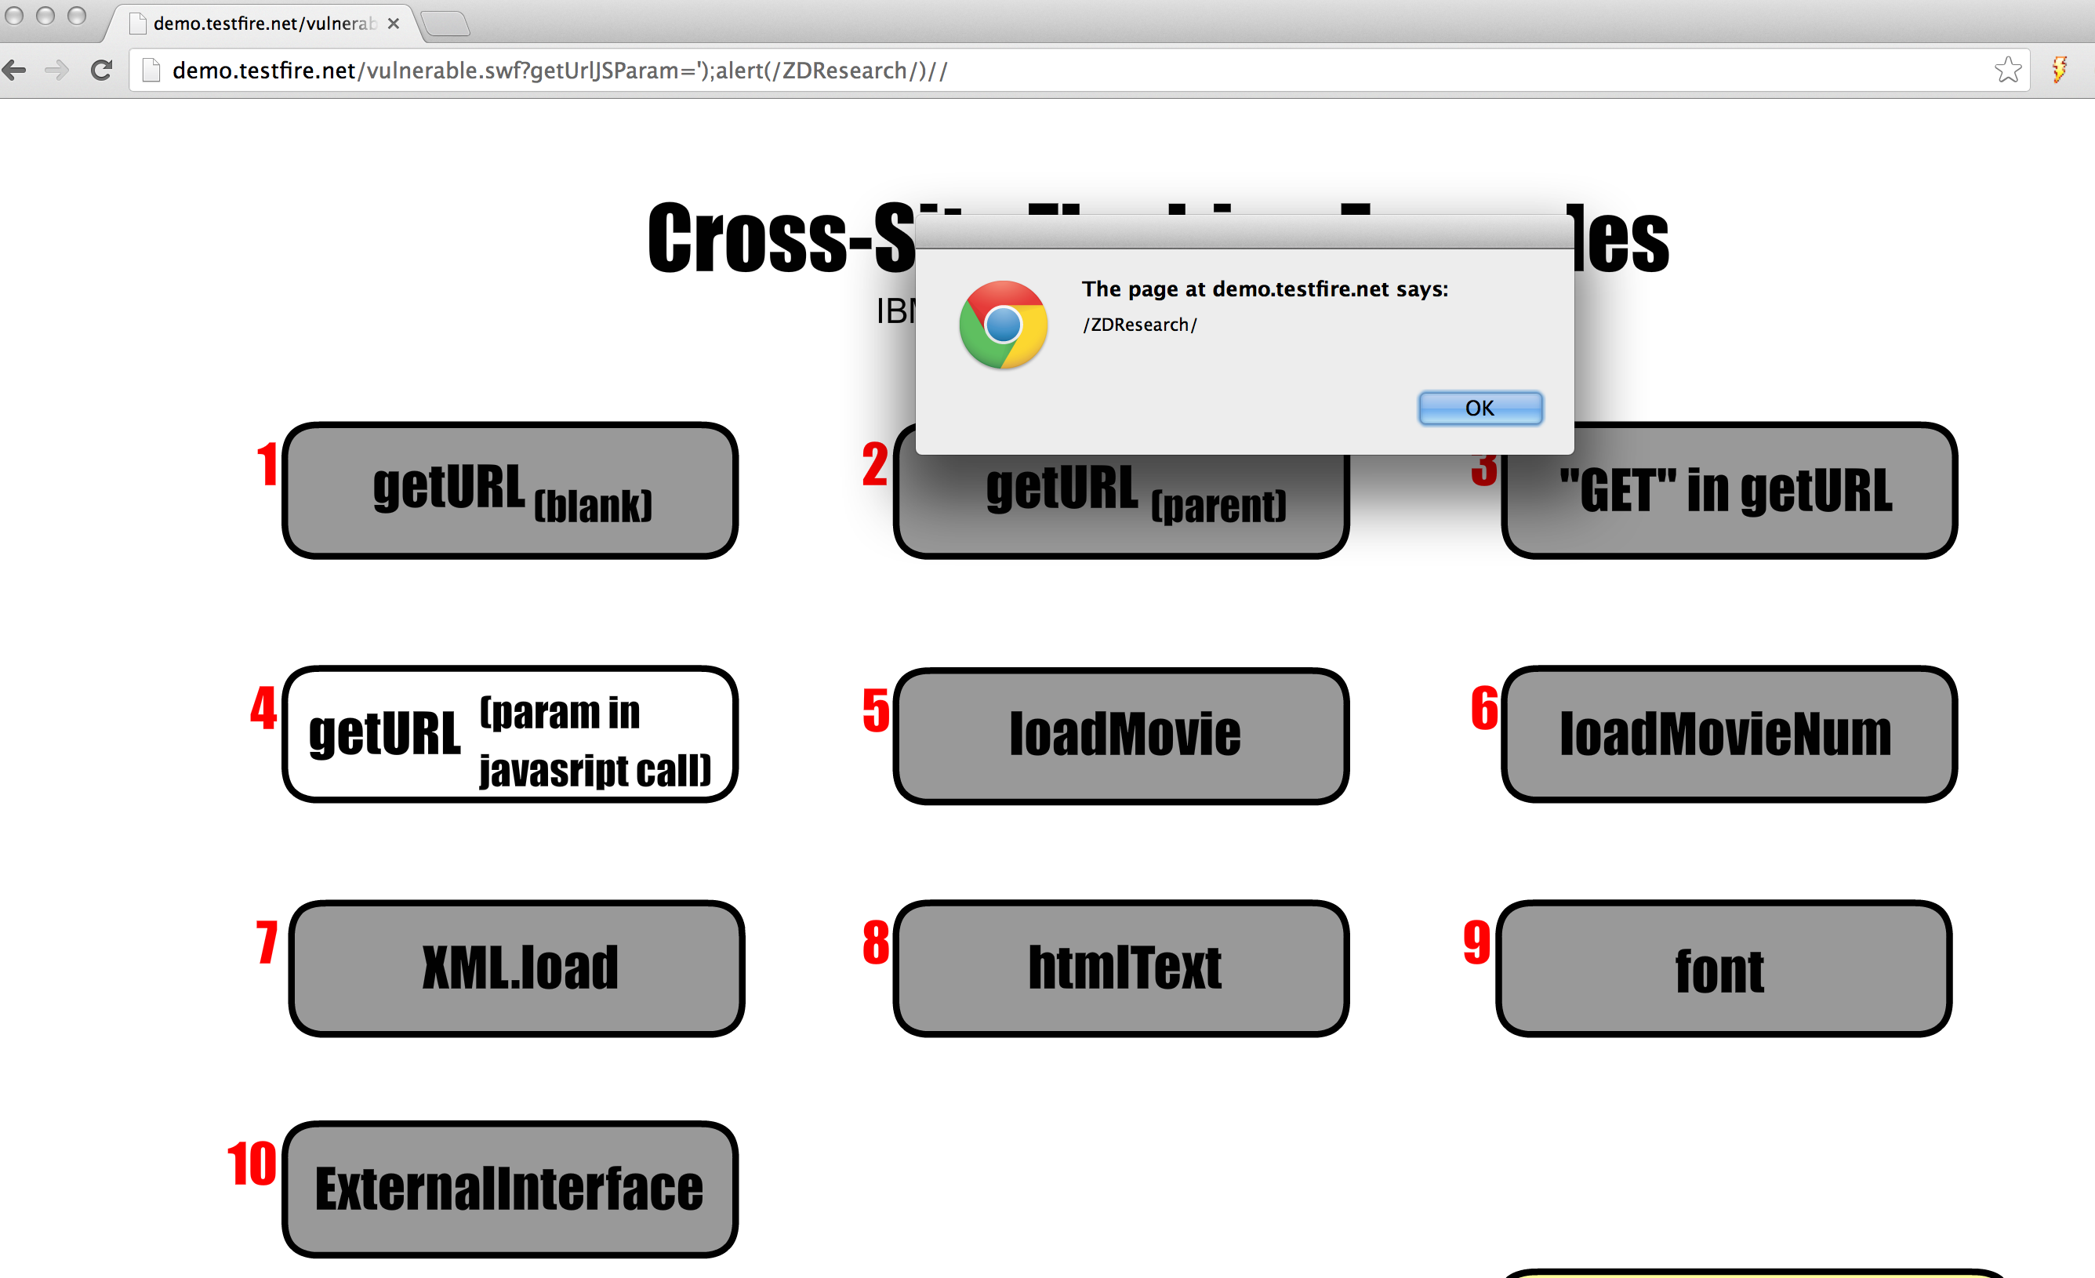
Flash based XSS
So all lets try following URL:
http://demo.testfire.net/vulnerable.swf?getUrlJSParam=');alert(/ZDResearch/)//

Slide 18
Flash based XSS
So all of classic flash based XSS attacks are almost same you need to find a variable that passed some how to javascript or external caller. But this is not the only way we can XSS flash files. We are in advanced web hacking course so you should be creative. some times loading another SWF file , loading HTML file, loading XML file, calling a socket may result XSS attack so for getting best result you should audit code correctly not only searching for patterns. Lets just look at number 8 htmlText In our example. Here is the code.
on (release) { if (txtFieldExists == false) { this.createtextfield("txtField", this.getnexthighestdepth(), 270, 270, 160, 22); txtField.html = true; txtFieldExists = true; } txtField.htmltext = htmlVar; }

Slide 19
Flash based XSS
Lets try inject text parameter like: http://demo.testfire.net/vulnerable.swf?htmlVar=ZDResearch
now click on htmlText and will see ZDResearch text now lets try inject html code
Again click on htmlText and then click on Click Here again you will got alert message .
http://demo.testfire.net/vulnerable.swf?htmlVar=<a href="javascript:alert(/ZDResearch/)"> Click here</a>

Slide 20
Flash based XSS
So as you can see this be be completely different than only JS vectors so for now you can pause reading slides and go and work on other examples In http://demo.testfire.net/vulnerable.swf try to understand different vectors and method and try to understand it at code level . If you need help on each attacks you can do cheat and click on show attacks button in vulnerable SWF.

Slide 21
Flash based XSS
So at end you can use my wordlist for start auditing every SWF file.
addCallback allowDomain currentDomain ExternalInterface eval FileReference Fscommand getURL htmlText Loader loadBytes LoadVars LoadVariables LoadMovie LocalConnection navigateToURL sendToURL SharedObject Socket XMLSocket password JavaScript

Slide 22
Fuzzing Flash
Now as you learnt about manual SWF code review and vulnerability discovery it’s cool to look at some vulnerability hunting automation using available tools .

Slide 23
SWF Investigator
The best tool right now for doing flash fuzzing is SWF Investigator . So please download and install adobe AIR and SWF investigator before continue.
http://get.adobe.com/air/
http://labs.adobe.com/technologies/swfinvestigator/
Note that we can use SWF investigator in both MAC and windows.

Slide 24
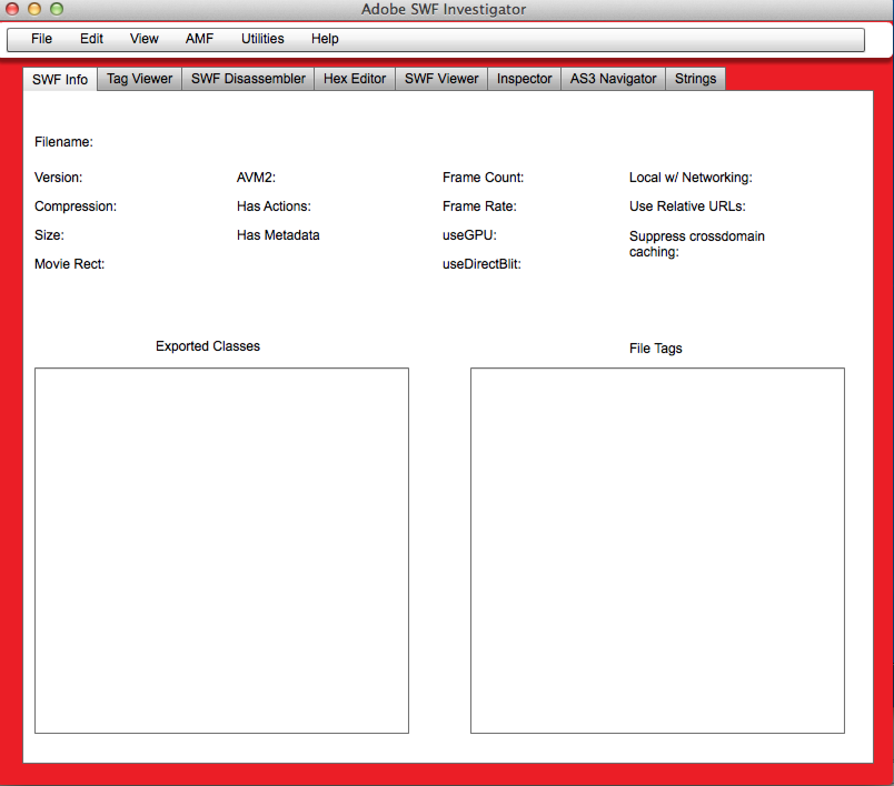
SWF Investigator
After you installation process you can run the tool .

Slide 25
SWF Investigator
Now please download and load this sample in SWF investigator.
https://github.com/evilcos/xss.swf/blob/master/xss.swf
Now let me explain tabs quickly
SWF Info : so here you can get quick review of your targeted SWF
Tag viewer : show available tags inside your SWF
SWF disassembler : show SWF byte codes
HEX Editor : the name is clear this is hex editor tab !
SWF viewer: for testing SWF files using different initialization parameters you can change parameters and run it again also support for cookies .
Inspector : name is clear you can use it for inspecting SWF files behave different in AS2 and AS3 .
Navigator : will work on AS3 only will show you classes and methods and you can disassemble them more organized .

Slide 26
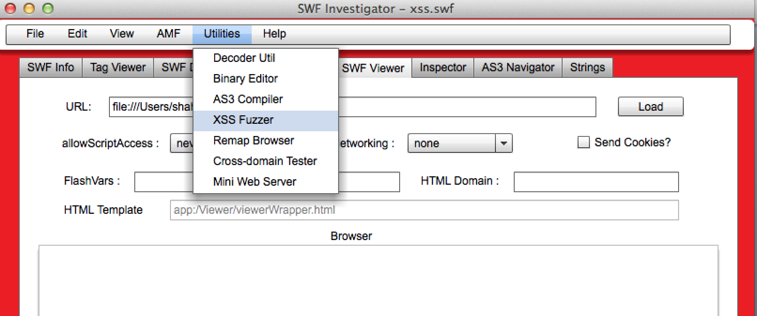
SWF Investigator
Ok so you know how this tool is cool but we are at XSS session and we want use this tool to find XSS what we should do now ? We can use XSS fuzzer from utilities .

Slide 27
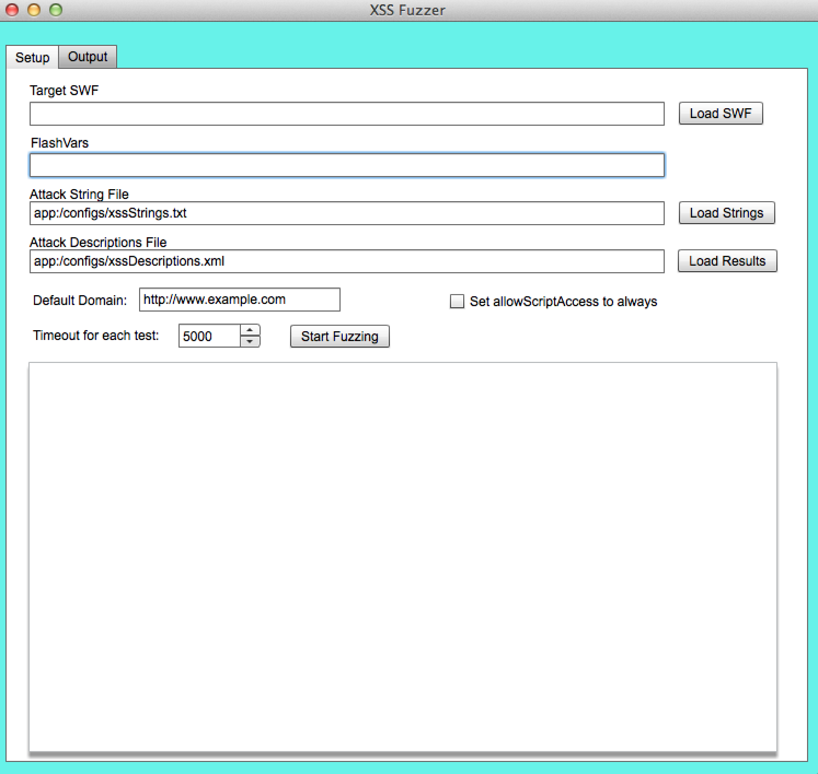
SWF Investigator
So here is main window of XSS fuzzer .

Slide 28
SWF Investigator
As you can see in window we need FlashVars to make fuzzer work. Lets cheat and take a look at our target source code .
https://github.com/evilcos/xss.swf/blob/master/xss_source.txt
As you can see loderinfo is used for param object and then we have to string parameter called a and c .
var param:Object = root.loaderInfo.parameters; var action:String = param["a"]; var cmd:String = param["c"];

Slide 29
SWF Investigator
Now lets look at switch code .
As you can see switch performed on action and cmd is passed to AS
switch (action) { case "location" :// location URL navigateToURL(new URLRequest(cmd),"_self"); break; case "open" :// open URL navigateToURL(new URLRequest(cmd),"_blank"); break; case "get" :// GET var loader:URLLoader = new URLLoader(new URLRequest(cmd)); loader.addEventListener(Event.COMPLETE,get_complete); loader.addEventListener(SecurityErrorEvent.SECURITY_ERROR,get_sec_error); break; case "eval" :// execute JS flash.external.ExternalInterface.call("eval", cmd); break; default : var help:String = 'a(action) - c(cmd)\n'; help += '-----------------\n'; help += '1. location to url: xss.swf?a=location&c=http://www.google.com/\n'; help += '2. open url to new window: xss.swf?a=open&c=http://www.google.com/\n'; help += '3. http request to url: xss.swf?a=get&c=http://www.google.com/\n'; help += '4. eval js codz: xss.swf?a=eval&c=alert(document.domain)\n'; help += '-----------------\n'; help += 'by evilcos@gmail.com'; flash.external.ExternalInterface.call("alert", help); break; } stop(); }

Slide 30
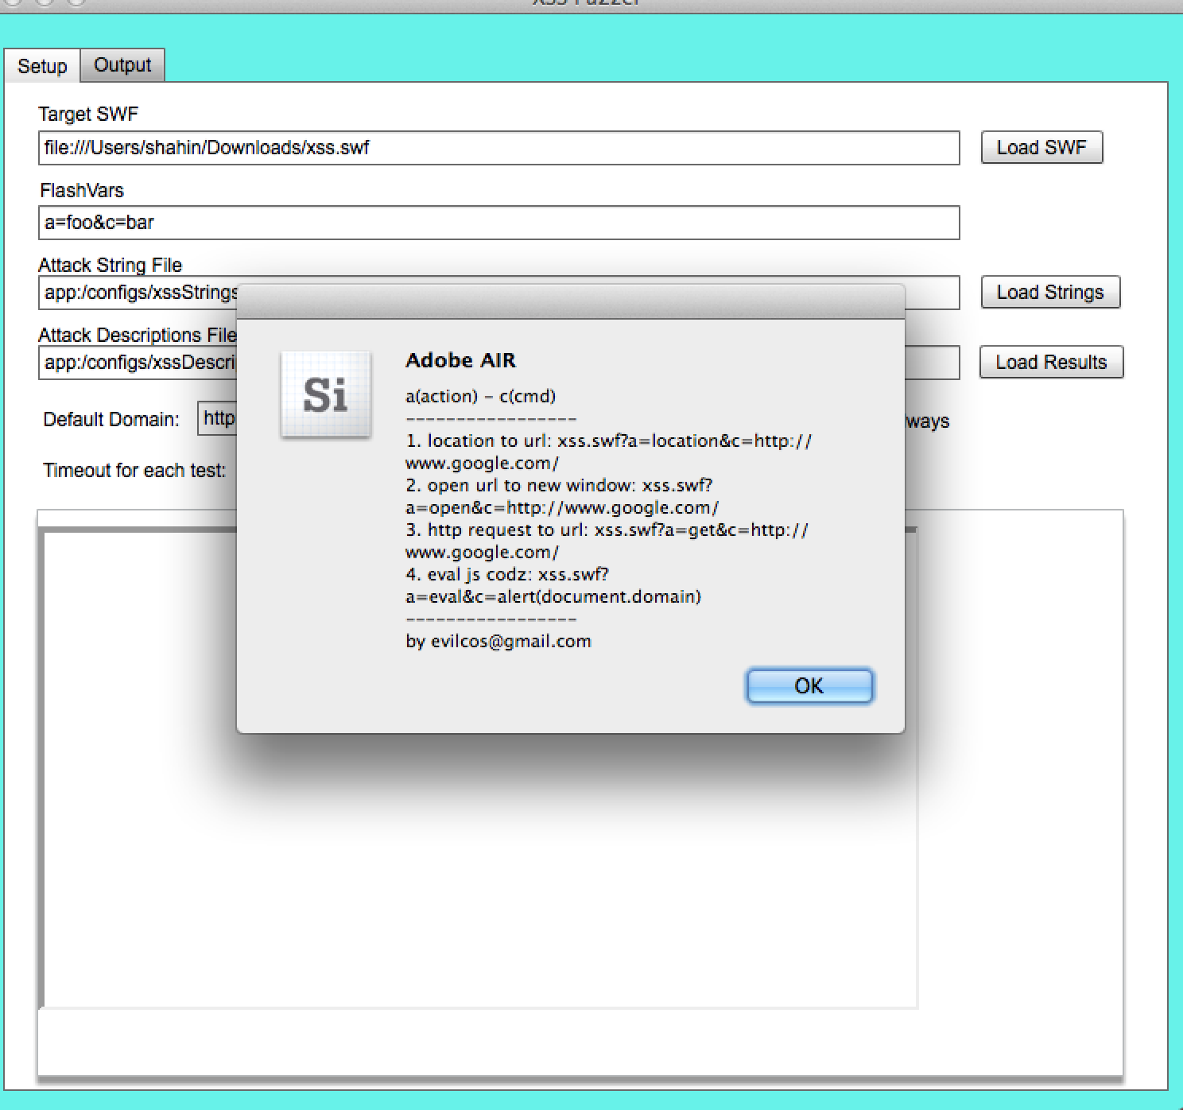
SWF Investigator
So lets configure investigator like following figure . And press start fuzzing . As you can see each time it will give you usage message .

Slide 31
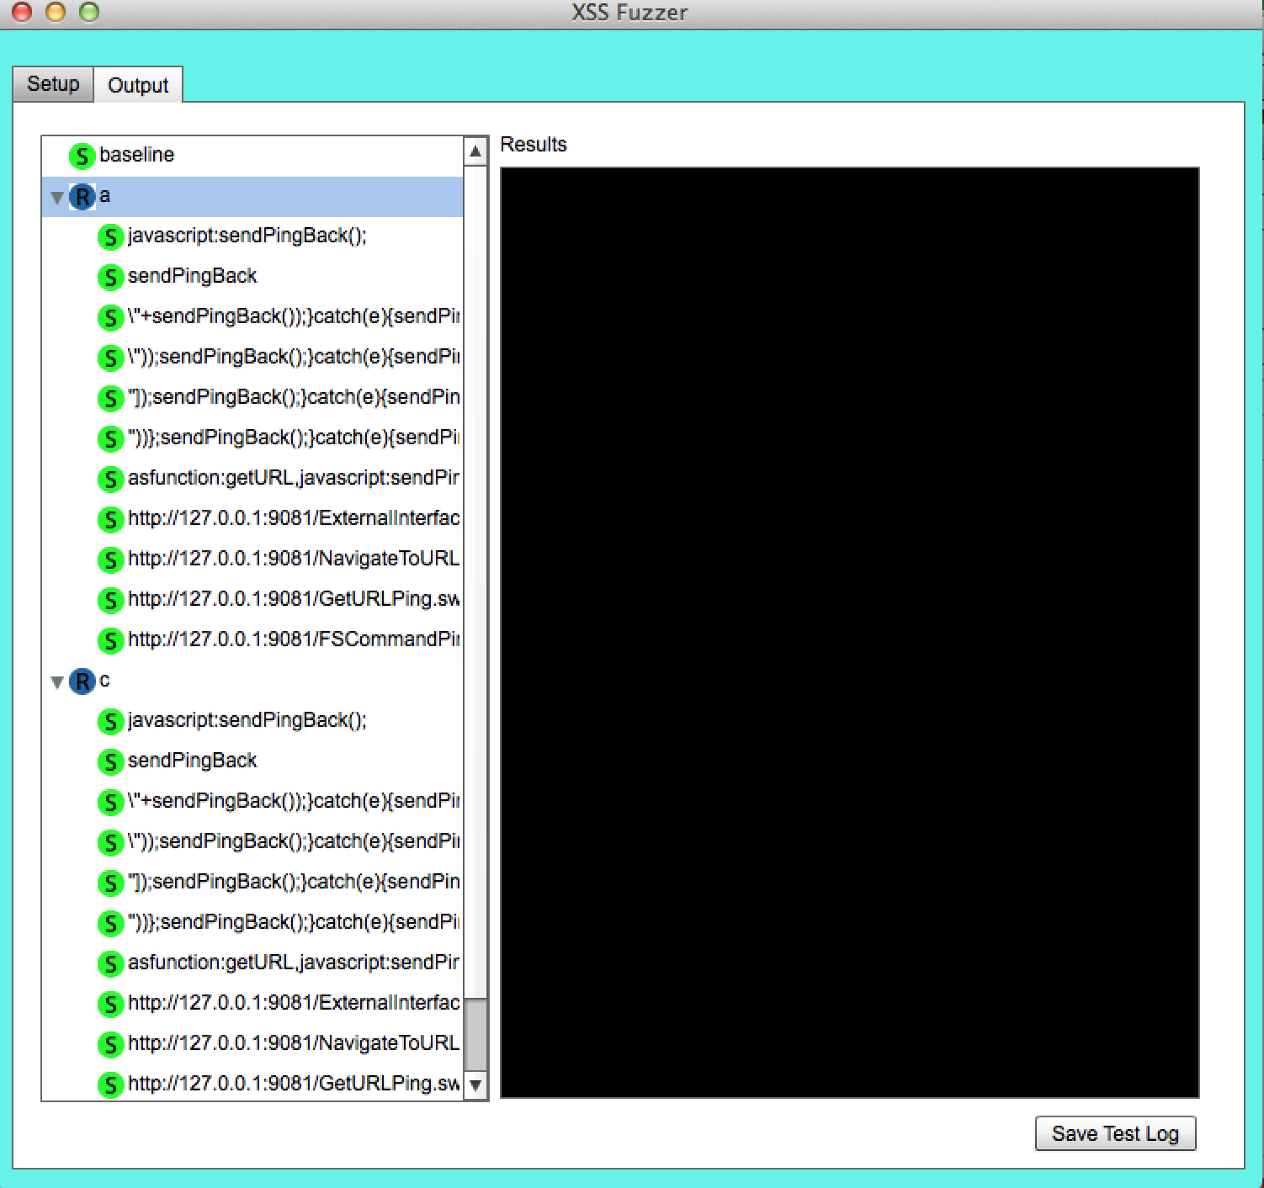
SWF Investigator
After you passed massaged in few minutes you will have result in output tab and as you can see no XSS founded !

Slide 32
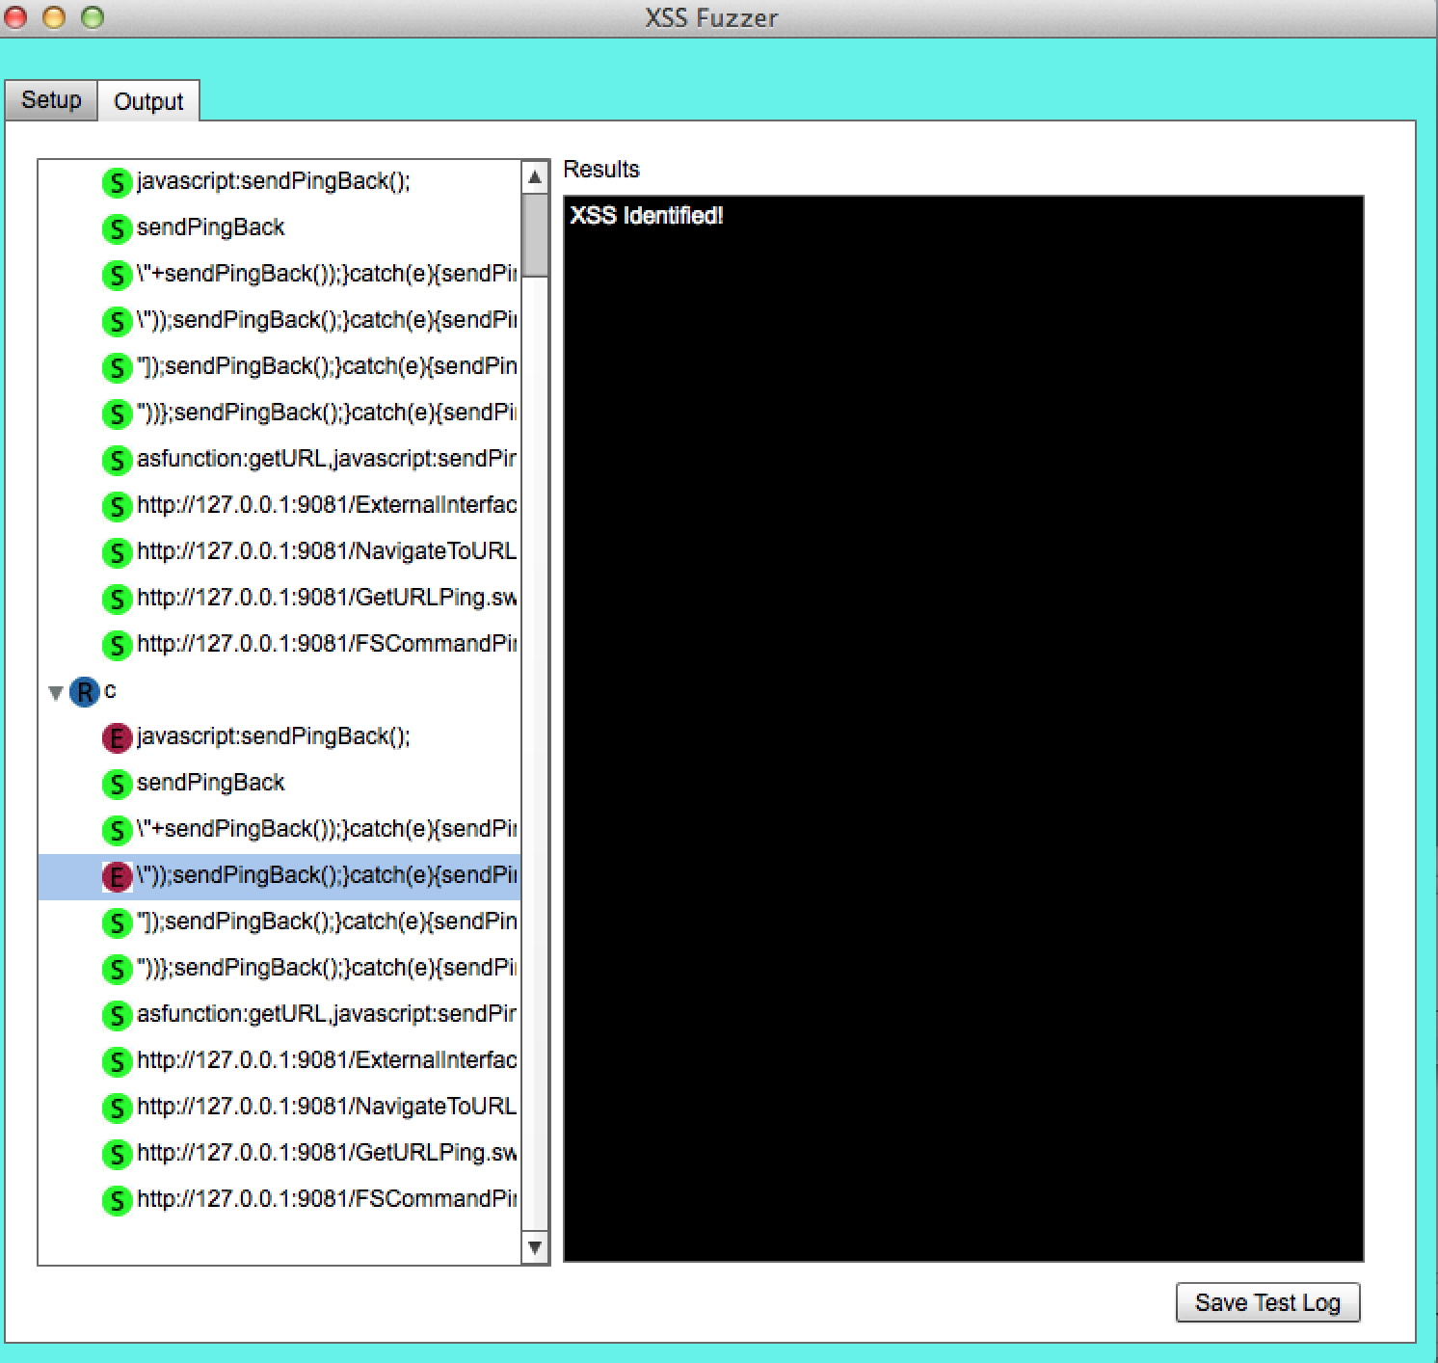
SWF Investigator
So tool didn’t find any vulnerability. Why ? Maybe because we need better initialization variable refer to our switch/case code lets try a=eval&c=foo for our FlashVars and try again.

Slide 33
SWF Investigator
As you can see this time the XSS identified correctly so it’s important to keep in mind even if you are performing fuzzing it’s good point to check for initialization variables before doing totally dump fuzzing for getting better and more effective result.
For now we are at end of this session and like pervious chapters we want to do demo on real world example our real world example here is Fixed Flash Based XSS on Yahoo! Mail .

Slide 34
Demo
Demo : Fixed Flash Based XSS on Yahoo! Mail

