Slide 1
Notes:
Hi everyone and welcome to the zdresearch exploitation course, I am ahmad and going to introduce this course in this sample chapter.

Slide 2
WARNING! Sample chapter
Materials in this sample chapter is selected from chapter 4: Integer issue to anything
The materials will be covered in more detail in it’s own chapter
We are going to exploit an integer overflow (CVE-2011-2110 )
I hope you will enjoy it!
Notes:
I chosen some materials from the fourth chapter of this course as a sample. Notice that The materials in this chapter will be covered in more detail in the chapter titled integer issue to anything. So don’t worry about the contents. I mean for example if you don’t understand some concept, we will cover it step by step from basics in the actual course. In this sample chapter we are going to exploit CVE-2011-2110 and I hope you will enjoy it.

Slide 3
Signed/Unsigned integer
In c/c++ language integer declaration are signed by default: short, int, long, …
To declare unsigned integer: unsigned prefix
Signed integer can store any integer (-x, +x)
Unsigned integer can store 0 and postivie values (0, +x)
unsigned int a = 10; if( a > 5) { //do something char * x = 0; } int b = -2; if( b > 5) { //do something char * x = 0; }
Notes:
Well, the mentioned vulnerability that we are going to exploit is an integer overflow bug. So we are going to start with the general concept integers. In c/c++ language integers are signed variables by default means they can contiain negative, 0, positive numbers. To declare a variable as unsigned we use the prefix unsigned.

Slide 4
Signed/Unsigned integer – Cont’d
Low level machine code
Machine code know nothing about unsigned prefix
Compiler generate proper instruction for unsigned/signed values
CPU assign/check different flags for different instructions
Example: JBE v.s JLE
JBE: jump if (CF=1 or ZF=1)
JLE: jump if (SF<>OF or ZF=1)
0117136E mov dword ptr [a],0Ah if( a > 5) 01171375 cmp dword ptr [a],5 01171379 jbe main+32h (1171382h) { //do something char * x = 0; 0117137B mov dword ptr [x],0 } int b = -2; 01171382 mov dword ptr [b],0FFFFFFFEh if( b > 5) 01171389 cmp dword ptr [b],5 0117138D jle main+46h (1171396h) { //do something char * x = 0; 0117138F mov dword ptr [x],0 }
Notes:
Now look at the integer concept at lower level mean machine code level. Machine code doesn’t know anything about unsigned prefixes. So how a machine code differentiate between signed and unsigned. Well here is generated machine code(or human readable assembly code ) of the previous example. As you see a dword memory is used to store the unsigned value a. and here the same dword, I mean same type of memory is used to store signed variable B. so there is no difference between the memory used for them. But the difference is about the generated instruction for comparison. The compiler generate jbe instruction for unsigned variable and later jle for signed variable. Jbe is for jump below or equal and jle is jump low or equal!

Slide 5
Signed/Unsigned integer – Cont’d
Low level machine code
Some of the instructions:
0117136E mov dword ptr [a],0Ah if( a > 5) 01171375 cmp dword ptr [a],5 01171379 jbe main+32h (1171382h) { //do something char * x = 0; 0117137B mov dword ptr [x],0 } int b = -2; 01171382 mov dword ptr [b],0FFFFFFFEh if( b > 5) 01171389 cmp dword ptr [b],5 0117138D jle main+46h (1171396h) { //do something char * x = 0; 0117138F mov dword ptr [x],0 }
Signed | Unsigned
IDIV | DIV
IMUL | MUL
SAL | SHL
SAR | SHR
JL | JB
JG | JA
… | …
Notes:
Here you can see more of such intstructions. DIV/IDIV, MUL/IMUL … and the difference is between them is the cpu flag checks or assignments.

Slide 6
Signed/Unsigned integer – Cont’d
As an example a Short integer (16 bit) store the same way in CX register signed or unsigned:
CX
0xfe12
1111111000010010
Unsgined
65042
Not
signed
0000000111101101
-1ED
-493
Notes:
Computer science students are so familiar with this concept. Here you can see a imaginary view of CX register memory that contains 0xfe12 hexadecimal value. Well CPU know how to handle the difference between signed and unsigned value with help it’s flag register. but consider we are going to debug some program and we see CX register contain this value. In case of unsie gned value the conversion is straight. Sixty –five thousand o forty two. But in case of a signed variable we should check the first bit. If the first bit is not set we are going to deal with a positive number and if the first bit is sets we have a negative number. To convert this negative number to It’s decimal counterpart, we can use a not operator. Then convert the result to decimal value with the addition of a minus . So here you see how we can consider a value as a negative signed or a large unsginned value.

Slide 7
Integer Overflow
Can be occurred because of:
Signedness issue
improper or lack of checks
Occurs when a memory or register is able to store larger number value than the programmer expected.
Is a bug not a vulnerability
Is not a memory corruption but can cause memory corruption so vulnerability
Notes:
Integer overflow bugs can be occurred because of signess issue or and improper or lack of checks against integer inputs. Don’t worry we will discuss about signedness issue. It Occurs when a memory or register is able to store larger number value than the programmer expected. As you see I told integer overflow bug not vulnerability. The reason is that integer overflows are not vulnerability by itself. Well some one can not say that woow I found an Integer overflow in google chrome so I can pwn it! This is not a memory corruption and vulnerability but can cause some condition that lead to memory corruption so the vulnerability

Slide 8
Signedness issue example
#include <stdio.h> int main(int argc, char* argv[]) { if (argc != 2) return -1; unsigned int i = atoi(argv[1]); if( i > 100 ) { printf("high temperature"); } else { printf("low temperature"); } return 0; }
Notes:
I mentioned signed issue example . Here is the demonstrations code for the issue. It looks like a simple conditional statement learning in c/c++ code. Check the inputs if higher than a hundred alert high temperature else alert low temperature.
As an attacker we can not heat the system to turn it off but we have an improper declaration of integer variable. So if we freeze the environment or sensors we can pass a negative number as temperature to this program. But the program consider our negative number as a big positive number so the invalid condition would be met and we can cause denial of service by freezing!

Slide 9
Signedness issue example
What programmer expected?
The program checks if temperature (integer input) is greater than some value.
Detect high temperature
Turn of the pump or any device
Attacker view
There is an improper declaration of temperature variable, So integer signedness issue.
The device can be turned off by freezing the environment:
Causing DOS
Or maybe Security bypass
Notes:
Consider this simple program as a code of some security system. Our imaginary security system uses heat level of environment. What programmer expect is that when the heat level goes up the system checks temperature against some value and detect high temperature and turn off the device.

Slide 10
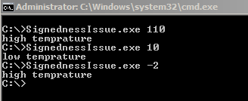
Signedness issue example
OK
OK
Buggy!
Unsafe
009E13D5 cmp dword ptr [i],64h
009E13D9 jbe main+64h (9E13F4h)
unsigned int i = atoi(argv[1]);
Safe
009E13D5 cmp dword ptr [i],64h
009E13D9 jle main+64h (9E13F4h)
int i = atoi(argv[1]);
Notes:
Here is the result of such issue. A hundred and ten is ok high temp, ten is a low temp and is ok, but minues two is not a high temp, so buggy!!! You can see how a simple proper declartion of variable can patch this vulnerability. And here is the binary equivalent.

Slide 11
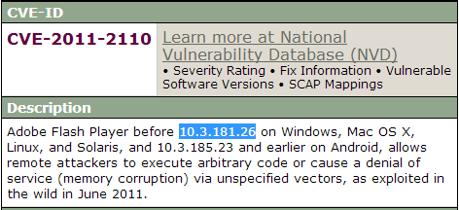
CVE-2011-2110
Product:
Flash player before 10.3.181.26
Bug class:
Array index integer overflow
Component:
AVM2 virtual machine

Slide 12
AVM2 virtual machine
Flash player is a plugin software that can be attacked via browser by convincing victims to malicious link.
ActionScript3 is a high level language embedded as AVM2 virtual machine in flash player
AVM2 virtual machine interpret bytecodes (delivered by SWF file ) to machine code.
So vulnerabilities in verification and processing of bytecodes can be occurred!
Notes:
Flash player is a popular plugin accessible through any browser. It can be attacked by malicious links via browser. Action script3 is a high level language developed by adobe by the release of flash player 9. AS3 is implemented by AVM2 virtual machine in flash player. Avm2 virtual machine takes bytecodes in form swf file as input and interpret and process them to machine code. So in the interpperetion and verification of these bytcodes lots of vulnerabilities can be occurred.

Slide 13
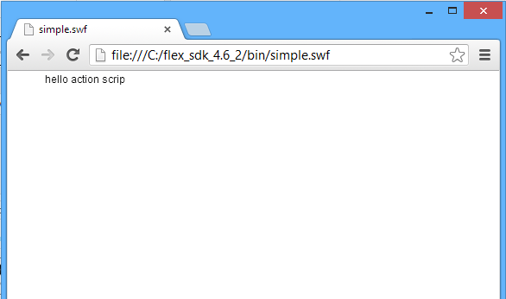
AVM2 virtual machine
Hello world AS3:
package { import flash.text.TextField; import flash.display.MovieClip; public class simple extends MovieClip { public function simple() { var availTxt:TextField = new TextField(); addChild(availTxt); availTxt.appendText("hello action script" ); } } }
C:\flex_sdk_4.6_2\bin>mxmlc simple.as
Notes:
Hello world of action script. Can be simply compiled by mxmlc command line compiler from flex SDK. And here is the result.

Slide 14
AVM2 virtual machine
.swf file
Swf Header
FileAttributes Tag
.as source
X Tag
Browser
package {
import flash.text.TextField;
import flash.display.MovieClip;
public class simple extends MovieClip
{
public function simple()
{
var availTxt:TextField = new TextField();
addChild(availTxt);
availTxt.appendText("hello action script" );
}
}
}
… Tag
Flash Player Plugin
Mxmlc.exe compiler
DoABC Tag
ABCFile
AVM2 Virtual machine
Constants
ByteCodes
Other stuffs…
End Tag
Notes:
Here is the architecture of AVm2 . Source code of action script code .as is compiled by mxmlc to ABCFile structure. The abc file structure is part of DOAbc tag in swf file. ABCFile contains all the things that AVM2 need to execute bytecodes. When a swf file is loaded in to the browser, the browser pass this file to flash player plugin. Flash player parse the swf file and pas the ABCFile to it’s embedded AVM2 virtual machine. The attac vector here is the swf file that can be made by mxmlc compiler and direct manipulation of swf file via hex editors.

Slide 15
CVE-2011-2110 – Cont’d
Proof of concept AS3 Code triggering the vulnerability:
package { import flash.display.*; public class flashplayer extends MovieClip { public function flashplayer() { crash(1); } public function exploit(... args) : void { String(args[0xf0000000]); } } }
Notes:
Lets get back to the vulnerability. Here is the proof of concept action script code that can trigger this vulnerability.

Slide 16
CVE-2011-2110 – Cont’d
DEMO
Crash under the debugger
Notes:
Well here we compile this code via mxlmc compiler. Here is the vulnerable flash player. And let’s attach some debugger. And booom!

Slide 17
Array index overflow
Overflowed integer can be an array index
Based on the array usage it can also be a critical vulnerability, examples:
CVE-2013-2551 Pwn2Own 2013 IE 10
CVE-2011-2371 Firefox 4.0.1 Array.reduceRight
Notes:
We previously mentioned the vulnerability as an array index vulnerability. The overflowing integer input can be later used as an index to an array. Based on the array usage it can lead to a critical vulnerability. Here are some other examples of such vulnerabilties.

Slide 18
Array index overflow – Cont’d
Array index overflow demonstration
#include <stdio.h> void f0(char *c){ printf("0%s", c);}; void f1(char *c){ printf("1%s", c);}; void f2(char *c){ printf("2%s", c);}; void f3(char *c){ printf("3%s", c);}; void f4(char *c){ printf("4%s", c);}; void f5(char *c){ printf("5%s", c);}; void f6(char *c){ printf("6%s", c);}; void f7(char *c){ printf("7%s", c);}; void f8(char *c){ printf("8%s", c);}; void f9(char *c){ printf("9%s", c);}; typedef struct Structure1 { void (*ptrFunctions[10])(char *); char buff[100]; };
void initStructure(Structure1 * str1, char * message) { str1->ptrFunctions[0] = f0; str1->ptrFunctions[1] = f1; str1->ptrFunctions[2] = f2; str1->ptrFunctions[3] = f3; str1->ptrFunctions[4] = f4; str1->ptrFunctions[5] = f5; str1->ptrFunctions[6] = f6; str1->ptrFunctions[7] = f7; str1->ptrFunctions[8] = f8; str1->ptrFunctions[9] = f9; strcpy(str1->buff, message); }
int main(int argc, char* argv[]) { if (argc != 3) return -1; Structure1 str1; initStructure(&str1, argv[2]); int number = atoi(argv[1]); if ( number < 10) str1.ptrFunctions[number](str1.buff); return 0; }
Notes:
Now let’s examine array indexing on demonstration code. Here we have lots of function pointers and a data structure containing array of function pointers and a variable for storing message. The lazy programmer ( of course it was me! ). The program takes a command number and a message and the lazy programmer uses the command number as index instead of a switch case. The programmer checks number if less than ten to stop anyone from passing invalid command number.

Slide 19
Array index overflow – Cont’d
The program uses index value directly instead of switch case to an array of function pointers
Print command number with a message
Check for command number less than 10
But invalid variable type declaration cause signedness issue, So!
C:\>indexOverflow.exe 5 hello 5hello C:\>indexOverflow.exe 7 goodbye 7goodbye
Notes:
so here are the steps : the program index the input to array of function pointers, and print numbers with command . It checcks command number less than 10. but again we have a siigness issue here.

Slide 20
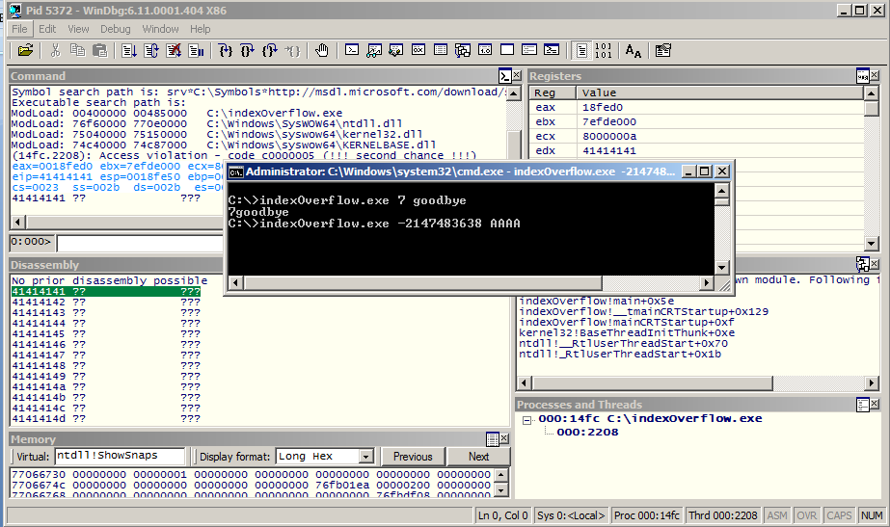
Array index overflow – Cont’d

Slide 21
CVE-2011-2110 – Cont’d
DEMO
Vulnerability analysis
Notes:
Let’s trigger the issue again. Here is the code, the code on IDA is like this, here the program checks if number is less than 0 but improper checsk. So …. Uses atom and so..

Slide 22
CVE-2011-2110 – Cont’d
AVM2 Atom
Object data
Type
Object - 001 String - 010 NameSpace - 011 Undefined - 100 Boolean - 101 Integer - 110 Double - 111
Notes:
Atoms are variables of avm2. and atom can contains anything. Here is the structure of atom. The first 3bits of any atom is used for specifying it’s type and the remaining bits are the actual variable pointer or value.

Slide 23
CVE-2011-2110 – Cont’d
*
When we crash at: mov eax, [ecx+eax*4], eax register is under control and ecx is the pointer to the array
ecx is a pointing to offset +0x108 of esp register so the array is on the stack memory
So we can dereference any offset in the virtual memory with base of current thread stack.
Current thread Stack
0X00000000
ESP
ECX
[ECX+EAX*4]
By changing eax value any offset can be returned.
0X7FFFFFFF

Slide 24
CVE-2011-2110 Exploitation
What we have?
A bug that let us dereference any value from memory as AS3 atom.
The atom can be manipulated by high level AS3 code.
What we do?
Read some controllable value from memory as atom
Pass it to some other AS3 function that threat our atom as a fake object.
Fake object has fake vftable, so calling any of it’s virtual functions lead to exploitable condition
Notes:
We have a bug to dereference any value from memory avm2 atom. The atom atom can be manipulated by other functionality of the environment. What we gonna do? Read some controllable value from memory of the atom then pass it to some other

Slide 25
CVE-2011-2110 Exploitation
DEMO
Derefrencing the meat
Notes:
Push controllable value on the stack by some testing, calculate offset of that value.

Slide 26
CVE-2011-2110 Exploitation
We have our controllable value on the stack
We should find the proper index to dereference it as atom, Solving the equation:
ecx - 200 = ecx + eax * 4 -200 = eax * 4 eax = -200 / 4 -> eax = 0xFFFFFF38 / 4 -> eax = 4294967096 / 4 eax = 4294967096 / 4 = 1073741774 = 0x3FFFFFCE
Notes:
Solve the equationg. Find proper index value. Pass it and check it again under the debugger.

Slide 27
CVE-2011-2110 Exploitation
DEMO
Gaining EIP
Notes:
Pass the ckeckd value to some other part to get exection.

Slide 28
Heap spray exploitation
Demonstrated in the wild mostly in browser exploitation but may be applied in other cases
Understanding it is better than doing it by copying and pasting available scripts from other exploits.
Restricted to 32bit environment
Easy but heavy

